Slide 1
Hill Cipher

Slide 2
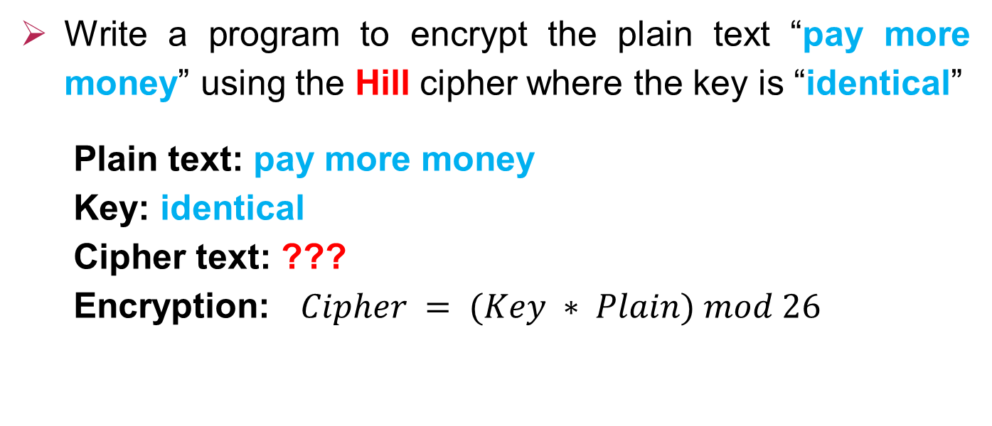
Encryption
Write a program to encrypt the plain text “pay more money” using the Hill cipher where the key is “identical”
Plain text: pay more money
Key: identical
Cipher text: ???
Encryption: $Cipher = (Key ∗ Plain) mod 26$

Slide 3





0 | 1 | 2 | 3 | 4 | 5 | 6 | 7 | 8 | 9 | 10 | 11 | 12 | 13 | 14 | 15 | 16 | 17 | 18 | 19 | 20 | 21 | 22 | 23 | 24 | 25
a | b | c | d | e | f | g | h | i | j | k | l | m | n | o | p | q | r | s | t | u | v | w | x | y | z
$$\left[\begin{matrix}i & d & e \\ n & t & i \\ c & a & l\end{matrix}\right]$$
$$\left[\begin{matrix}8 & 3 & 4 \\ 13 & 19 & 8 \\ 2 & 0 & 11\end{matrix}\right]$$
Key
Plain text
$$\left(\begin{matrix}\begin{matrix}P_{1} & P_{2}\end{matrix} & \begin{matrix}P_{3} & P_{4}\end{matrix}\end{matrix}\right)$$
$$\left(\begin{matrix}\begin{matrix}p a y & m o r\end{matrix} & \begin{matrix}e m o & n e y\end{matrix}\end{matrix}\right)$$
$P_{1}=\left[\begin{matrix}p \\ a \\ y\end{matrix}\right]$ $\left[\begin{matrix}15 \\ 0 \\ 24\end{matrix}\right]$ $P_{2}=\left[\begin{matrix}m \\ o \\ r\end{matrix}\right]$ $\left[\begin{matrix}12 \\ 14 \\ 17\end{matrix}\right]$ $P_{3}=\left[\begin{matrix}e \\ m \\ o\end{matrix}\right]$ $\left[\begin{matrix}4 \\ 12 \\ 14\end{matrix}\right]$ $P_{4}=\left[\begin{matrix}n \\ e \\ y\end{matrix}\right]$ $\left[\begin{matrix}13 \\ 4 \\ 24\end{matrix}\right]$

Slide 4


0 | 1 | 2 | 3 | 4 | 5 | 6 | 7 | 8 | 9 | 10 | 11 | 12 | 13 | 14 | 15 | 16 | 17 | 18 | 19 | 20 | 21 | 22 | 23 | 24 | 25
a | b | c | d | e | f | g | h | i | j | k | l | m | n | o | p | q | r | s | t | u | v | w | x | y | z
Cipher text
$$\left(\begin{matrix}\begin{matrix}C_{1} & C_{2}\end{matrix} & \begin{matrix}C_{3} & C_{4}\end{matrix}\end{matrix}\right)$$
$$C_{1}=\left(Key∗P_{1}\right) mod 26$$
$=\left[\begin{matrix}8 & 3 & 4 \\ 13 & 19 & 8 \\ 2 & 0 & 11\end{matrix}\right]\left[\begin{matrix}15 \\ 0 \\ 24\end{matrix}\right]= \left[\begin{matrix}8∗15+3∗0+4∗24 \\ 13∗15+19∗0+8∗24 \\ 2∗15+0∗0+11∗24\end{matrix}\right]=\left[\begin{matrix}216 \\ 387 \\ 294\end{matrix}\right]$
$C_{1}=\left[\begin{matrix}8 \\ 23 \\ 8\end{matrix}\right]$ $\left[\begin{matrix}i \\ x \\ i\end{matrix}\right]$
Mod 26

Slide 5

0 | 1 | 2 | 3 | 4 | 5 | 6 | 7 | 8 | 9 | 10 | 11 | 12 | 13 | 14 | 15 | 16 | 17 | 18 | 19 | 20 | 21 | 22 | 23 | 24 | 25
a | b | c | d | e | f | g | h | i | j | k | l | m | n | o | p | q | r | s | t | u | v | w | x | y | z
$$C_{2}=\left(Key∗P_{2}\right) mod 26$$
$=\left[\begin{matrix}8 & 3 & 4 \\ 13 & 19 & 8 \\ 2 & 0 & 11\end{matrix}\right]\left[\begin{matrix}12 \\ 14 \\ 17\end{matrix}\right]= \left[\begin{matrix}8∗12+ 3∗14+4∗17 \\ 13∗12+19∗14+8∗17 \\ 2∗12+0∗14+11∗17\end{matrix}\right]=\left[\begin{matrix}206 \\ 558 \\ 211\end{matrix}\right]$
$C_{2}=\left[\begin{matrix}24 \\ 12 \\ 3\end{matrix}\right]$ $\left[\begin{matrix}y \\ m \\ d\end{matrix}\right]$
Mod 26

Slide 6

0 | 1 | 2 | 3 | 4 | 5 | 6 | 7 | 8 | 9 | 10 | 11 | 12 | 13 | 14 | 15 | 16 | 17 | 18 | 19 | 20 | 21 | 22 | 23 | 24 | 25
a | b | c | d | e | f | g | h | i | j | k | l | m | n | o | p | q | r | s | t | u | v | w | x | y | z
$$C_{3}=\left(Key∗P_{3}\right) mod 26$$
$=\left[\begin{matrix}8 & 3 & 4 \\ 13 & 19 & 8 \\ 2 & 0 & 11\end{matrix}\right]\left[\begin{matrix}4 \\ 12 \\ 14\end{matrix}\right]= \left[\begin{matrix}8∗4+ 3∗12+4∗14 \\ 13∗4+19∗12+8∗14 \\ 2∗4+0∗12+11∗14\end{matrix}\right]=\left[\begin{matrix}124 \\ 392 \\ 162\end{matrix}\right]$
$C_{3}=\left[\begin{matrix}20 \\ 2 \\ 6\end{matrix}\right]$ $\left[\begin{matrix}u \\ c \\ g\end{matrix}\right]$
Mod 26

Slide 7


0 | 1 | 2 | 3 | 4 | 5 | 6 | 7 | 8 | 9 | 10 | 11 | 12 | 13 | 14 | 15 | 16 | 17 | 18 | 19 | 20 | 21 | 22 | 23 | 24 | 25
a | b | c | d | e | f | g | h | i | j | k | l | m | n | o | p | q | r | s | t | u | v | w | x | y | z
$$C_{4}=\left(Key∗P_{4}\right) mod 26$$
$=\left[\begin{matrix}8 & 3 & 4 \\ 13 & 19 & 8 \\ 2 & 0 & 11\end{matrix}\right]\left[\begin{matrix}13 \\ 4 \\ 24\end{matrix}\right]= \left[\begin{matrix}8∗13+ 3∗4+4∗24 \\ 13∗13+19∗4+8∗24 \\ 2∗13+0∗4+11∗24\end{matrix}\right]=\left[\begin{matrix}212 \\ 437 \\ 290\end{matrix}\right]$
$C_{4}=\left[\begin{matrix}4 \\ 21 \\ 4\end{matrix}\right]$ $\left[\begin{matrix}e \\ v \\ e\end{matrix}\right]$
Mod 26
Cipher text
$$\left(\begin{matrix}\begin{matrix}C_{1} & C_{2}\end{matrix} & \begin{matrix}C_{3} & C_{4}\end{matrix}\end{matrix}\right)$$
IXIYMDUCGEVE

Slide 8
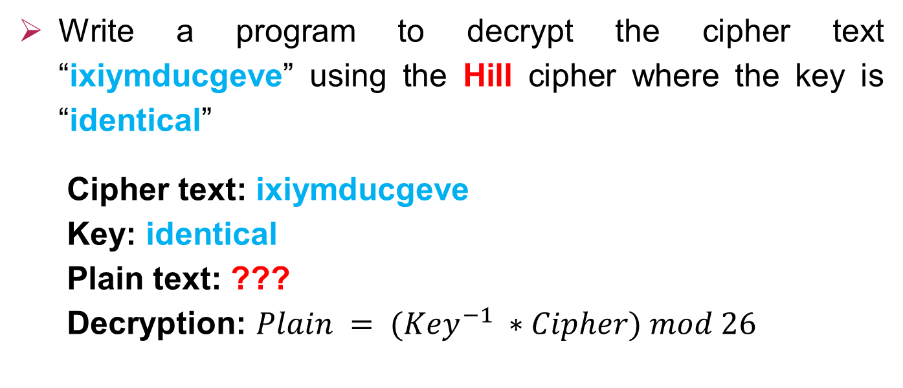
Decryption
Write a program to decrypt the cipher text “ixiymducgeve” using the Hill cipher where the key is “identical”
Cipher text: ixiymducgeve
Key: identical
Plain text: ???
Decryption: $Plain = ({Key}^{−1} ∗Cipher) mod 26$

Slide 9

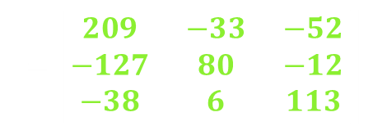
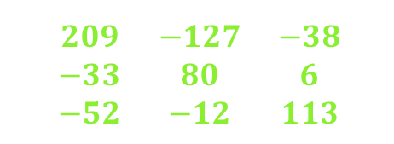

${Key}^{−1}= \left({Det}^{−1}∗Adj(Key)\right) mod 26 , Key=\left[\begin{matrix}8 & 3 & 4 \\ 13 & 19 & 8 \\ 2 & 0 & 11\end{matrix}\right]$ $\left[\begin{matrix}+ & − & + \\ − & + & − \\ + & − & +\end{matrix}\right]$
$$Adj\left(Key\right)= {\left[\begin{matrix}k_{11} & k_{12} & k_{13} \\ k_{21} & k_{22} & k_{23} \\ k_{31} & k_{32} & k_{33}\end{matrix}\right]}^{T}$$
$=$ ${\left[\begin{matrix}{209}_{ } & {−127}_{ } & {−38}_{ } \\ {−33}_{ } & {80}_{ } & 6_{ } \\ {−52}_{ } & {−12}_{ } & {113}_{ }\end{matrix}\right]}^{T}$
$$=\left[\begin{matrix}{209}_{ } & {−33}_{ } & {−52}_{ } \\ {−127}_{ } & {80}_{ } & {−12}_{ } \\ {−38}_{ } & 6_{ } & {113}_{ }\end{matrix}\right]$$
$$k_{11}=+\left|\begin{matrix}19 & 8 \\ 0 & 11\end{matrix}\right|=+\left(19∗11−0∗8\right)=209$$ $$k_{12}=−\left|\begin{matrix}13 & 8 \\ 2 & 11\end{matrix}\right|=−\left(13∗11−2∗8\right)=−127$$ $$k_{13}=+\left|\begin{matrix}13 & 19 \\ 2 & 0\end{matrix}\right|=+\left(13∗0−2∗19\right)=−38$$ $$k_{21}=−\left|\begin{matrix}3 & 4 \\ 0 & 11\end{matrix}\right|=−\left(3∗11−0∗4\right)=−33$$ $$k_{22}=+\left|\begin{matrix}8 & 4 \\ 2 & 11\end{matrix}\right|=+\left(8∗11−2∗4\right)=80$$ | $$k_{23}=−\left|\begin{matrix}8 & 3 \\ 2 & 0\end{matrix}\right|=−\left(8∗0−2∗3\right)=6$$ $$k_{31}=+\left|\begin{matrix}3 & 4 \\ 19 & 8\end{matrix}\right|=+\left(3∗8−19∗4\right)=−52$$ $$k_{32}=−\left|\begin{matrix}8 & 4 \\ 13 & 8\end{matrix}\right|=−\left(8∗8−13∗4\right)=−12$$ $$k_{33}=+\left|\begin{matrix}8 & 3 \\ 13 & 19\end{matrix}\right|=+\left(8∗19−13∗3\right)=113$$

Slide 10










${Key}^{−1}= \left({Det}^{−1}∗Adj(Key)\right) mod 26 , Key=\left[\begin{matrix}8 & 3 & 4 \\ 13 & 19 & 8 \\ 2 & 0 & 11\end{matrix}\right]$
$$Det \left(Key\right)=+8∗\left(19∗11−0∗8\right)−3∗\left(13∗11−2∗8\right)+4∗\left(13∗0−2∗19\right)$$
$$=1139 mod 26=21$$
$$Det∗{Det}^{−1} mod 26=1$$
$$21 ∗ 1 mod 26 =21 ≠1$$
$$21 ∗ 3 mod 26 =11 ≠1$$
$$21 ∗ 2 mod 26 =16 ≠1$$
$$21 ∗ 4 mod 26 = 6 ≠1$$
$21 ∗ 5 mod 26 = 1 ==1$
$${Det}^{−1}=5$$
$${Key}^{−1}=5∗\left[\begin{matrix}209 & −33 & −52 \\ −127 & 80 & −12 \\ −38 & 6 & 113\end{matrix}\right] mod 26$$
$$=\left[\begin{matrix}1045 & −165 & −260 \\ −635 & 400 & −60 \\ −190 & 30 & 565\end{matrix}\right]$$
$$\left[\begin{matrix}5 & 17 & 0 \\ 15 & 10 & 18 \\ 18 & 4 & 19\end{matrix}\right]$$
Mod 26
$$Det$$ | 1 | 3 | 5 | 7 | 9 | 11 | 15 | 17 | 19 | 21 | 23 | 25
$${Det}^{−1}$$ | 1 | 9 | 21 | 15 | 3 | 19 | 7 | 23 | 11 | 5 | 17 | 25

Slide 11





0 | 1 | 2 | 3 | 4 | 5 | 6 | 7 | 8 | 9 | 10 | 11 | 12 | 13 | 14 | 15 | 16 | 17 | 18 | 19 | 20 | 21 | 22 | 23 | 24 | 25
a | b | c | d | e | f | g | h | i | j | k | l | m | n | o | p | q | r | s | t | u | v | w | x | y | z
, ${Key}^{−1}=\left[\begin{matrix}5 & 17 & 0 \\ 15 & 10 & 18 \\ 18 & 4 & 19\end{matrix}\right]$
$Plain = ({Key}^{−1} ∗Cipher) mod 26$
Cipher text
$$\left(\begin{matrix}\begin{matrix}C_{1} & C_{2}\end{matrix} & \begin{matrix}C_{3} & C_{4}\end{matrix}\end{matrix}\right)$$
$$\left(\begin{matrix}\begin{matrix}i x i & y m d\end{matrix} & \begin{matrix}u c g & e v e\end{matrix}\end{matrix}\right)$$
$C_{1}=\left[\begin{matrix}i \\ x \\ i\end{matrix}\right]$ $\left[\begin{matrix}8 \\ 23 \\ 8\end{matrix}\right]$ $C_{2}=\left[\begin{matrix}y \\ m \\ d\end{matrix}\right]$ $\left[\begin{matrix}24 \\ 12 \\ 3\end{matrix}\right]$ $C_{3}=\left[\begin{matrix}u \\ c \\ g\end{matrix}\right]$ $\left[\begin{matrix}20 \\ 2 \\ 6\end{matrix}\right]$ $C_{4}=\left[\begin{matrix}e \\ v \\ e\end{matrix}\right]$ $\left[\begin{matrix}4 \\ 21 \\ 4\end{matrix}\right]$

Slide 12


0 | 1 | 2 | 3 | 4 | 5 | 6 | 7 | 8 | 9 | 10 | 11 | 12 | 13 | 14 | 15 | 16 | 17 | 18 | 19 | 20 | 21 | 22 | 23 | 24 | 25
a | b | c | d | e | f | g | h | i | j | k | l | m | n | o | p | q | r | s | t | u | v | w | x | y | z
Plain text
$$\left(\begin{matrix}\begin{matrix}P_{1} & P_{2}\end{matrix} & \begin{matrix}P_{3} & P_{4}\end{matrix}\end{matrix}\right)$$
$$P_{1}=\left({Key}^{−1}∗C_{1}\right) mod 26$$
$=\left[\begin{matrix}5 & 17 & 0 \\ 15 & 10 & 18 \\ 18 & 4 & 19\end{matrix}\right]\left[\begin{matrix}8 \\ 23 \\ 8\end{matrix}\right]= \left[\begin{matrix}5∗8+17∗23+0∗8 \\ 15∗8+10∗23+18∗8 \\ 18∗8+4∗23+19∗8\end{matrix}\right]=\left[\begin{matrix}431 \\ 494 \\ 388\end{matrix}\right]$
$P_{1}=\left[\begin{matrix}15 \\ 0 \\ 24\end{matrix}\right]$ $\left[\begin{matrix}p \\ a \\ y\end{matrix}\right]$
Mod 26

Slide 13


0 | 1 | 2 | 3 | 4 | 5 | 6 | 7 | 8 | 9 | 10 | 11 | 12 | 13 | 14 | 15 | 16 | 17 | 18 | 19 | 20 | 21 | 22 | 23 | 24 | 25
a | b | c | d | e | f | g | h | i | j | k | l | m | n | o | p | q | r | s | t | u | v | w | x | y | z
Plain text
$$\left(\begin{matrix}\begin{matrix}P_{1} & P_{2}\end{matrix} & \begin{matrix}P_{3} & P_{4}\end{matrix}\end{matrix}\right)$$
$$P_{2}=\left({Key}^{−1}∗C_{2}\right) mod 26$$
$=\left[\begin{matrix}5 & 17 & 0 \\ 15 & 10 & 18 \\ 18 & 4 & 19\end{matrix}\right]\left[\begin{matrix}24 \\ 12 \\ 3\end{matrix}\right]= \left[\begin{matrix}5∗24+17∗12+0∗3 \\ 15∗24+10∗12+18∗3 \\ 18∗24+4∗12+19∗3\end{matrix}\right]=\left[\begin{matrix}324 \\ 534 \\ 537\end{matrix}\right]$
$P_{2}=\left[\begin{matrix}12 \\ 14 \\ 17\end{matrix}\right]$ $\left[\begin{matrix}m \\ o \\ r\end{matrix}\right]$
Mod 26

Slide 14


0 | 1 | 2 | 3 | 4 | 5 | 6 | 7 | 8 | 9 | 10 | 11 | 12 | 13 | 14 | 15 | 16 | 17 | 18 | 19 | 20 | 21 | 22 | 23 | 24 | 25
a | b | c | d | e | f | g | h | i | j | k | l | m | n | o | p | q | r | s | t | u | v | w | x | y | z
Plain text
$$\left(\begin{matrix}\begin{matrix}P_{1} & P_{2}\end{matrix} & \begin{matrix}P_{3} & P_{4}\end{matrix}\end{matrix}\right)$$
$$P_{3}=\left({Key}^{−1}∗C_{3}\right) mod 26$$
$=\left[\begin{matrix}5 & 17 & 0 \\ 15 & 10 & 18 \\ 18 & 4 & 19\end{matrix}\right]\left[\begin{matrix}20 \\ 2 \\ 6\end{matrix}\right]= \left[\begin{matrix}5∗20+17∗2+0∗6 \\ 15∗20+10∗2+18∗6 \\ 18∗20+4∗2+19∗6\end{matrix}\right]=\left[\begin{matrix}134 \\ 428 \\ 482\end{matrix}\right]$
$P_{3}=\left[\begin{matrix}4 \\ 12 \\ 14\end{matrix}\right]$ $\left[\begin{matrix}e \\ m \\ o\end{matrix}\right]$
Mod 26

Slide 15



0 | 1 | 2 | 3 | 4 | 5 | 6 | 7 | 8 | 9 | 10 | 11 | 12 | 13 | 14 | 15 | 16 | 17 | 18 | 19 | 20 | 21 | 22 | 23 | 24 | 25
a | b | c | d | e | f | g | h | i | j | k | l | m | n | o | p | q | r | s | t | u | v | w | x | y | z
Plain text
$$\left(\begin{matrix}\begin{matrix}P_{1} & P_{2}\end{matrix} & \begin{matrix}P_{3} & P_{4}\end{matrix}\end{matrix}\right)$$
$$P_{4}=\left({Key}^{−1}∗C_{4}\right) mod 26$$
$=\left[\begin{matrix}5 & 17 & 0 \\ 15 & 10 & 18 \\ 18 & 4 & 19\end{matrix}\right]\left[\begin{matrix}4 \\ 21 \\ 4\end{matrix}\right]= \left[\begin{matrix}5∗4+17∗21+0∗4 \\ 15∗4+10∗21+18∗4 \\ 18∗4+4∗21+19∗4\end{matrix}\right]=\left[\begin{matrix}377 \\ 342 \\ 232\end{matrix}\right]$
$P_{4}=\left[\begin{matrix}13 \\ 4 \\ 24\end{matrix}\right]$ $\left[\begin{matrix}n \\ e \\ y\end{matrix}\right]$
Mod 26
Plain text
$$\left(\begin{matrix}\begin{matrix}P_{1} & P_{2}\end{matrix} & \begin{matrix}P_{3} & P_{4}\end{matrix}\end{matrix}\right)$$
paymoremoney

Slide 16
Thanks!

Slide 17
for i=1:len_key
key_index(i)=find(chars==key(i))-1;
end
key_index=reshape(key_index,Dimn,Dimn)';
key_det=mod(det(key_index),26);
if mod(key_det,2)~=0 &&key_det~=13
while mod(length(Plain_txt),Dimn)~=0
Plain_txt= strcat(Plain_txt,'x');
end
for i=1:Dimn:length(Plain_txt)
plan_char=Plain_txt(i:i+Dimn-1);
for j=1:length(plan_char)
plan_ind(j)=find(chars==plan_char(j))-1;
end
cipher_idx=key_index*plan_ind';
cipher_idx=mod(cipher_idx,26);
Cipher_txt(i:i+Dimn-1)=chars(cipher_idx+1);
end
Cipher_txt=upper(Cipher_txt);
else
disp('Error...');
end

